Slide 1
Smart LookUP
We give you the insights, You build the story !
Manikanta Reddy, Pranshu Gupta, Sumit Kalra

Slide 2
Introduction
Smart LookUP provides you with a new way to interact with your content.
It generates relevant information about the content you are viewing within
Google Chrome, easing your researching tasks.

Slide 3
Architecture
Smart LookUP has four major components
Content Reader
Topic Identifier
Insight Collector
User Interface
Smart LookUP

Slide 4
Architecture
Content Reader: Reads the content of the selected text from the page, with the help of Chrome APIs.
Topic Identifier: Identifies the domain or topic from the content with the help of Machine Learning APIs. These topics will help us extract content from web.
Insight Collector: Once the topics have been identified, Smart LookUP fetches the relevant content available over the web with the help of Web Search APIs. Fetched content is then sorted based on the different parameters such as relevance, date etc.
User Interface: GUI component of the Smart LookUP extensions displays the content in the same window as the web page in a pop-up.

Slide 5
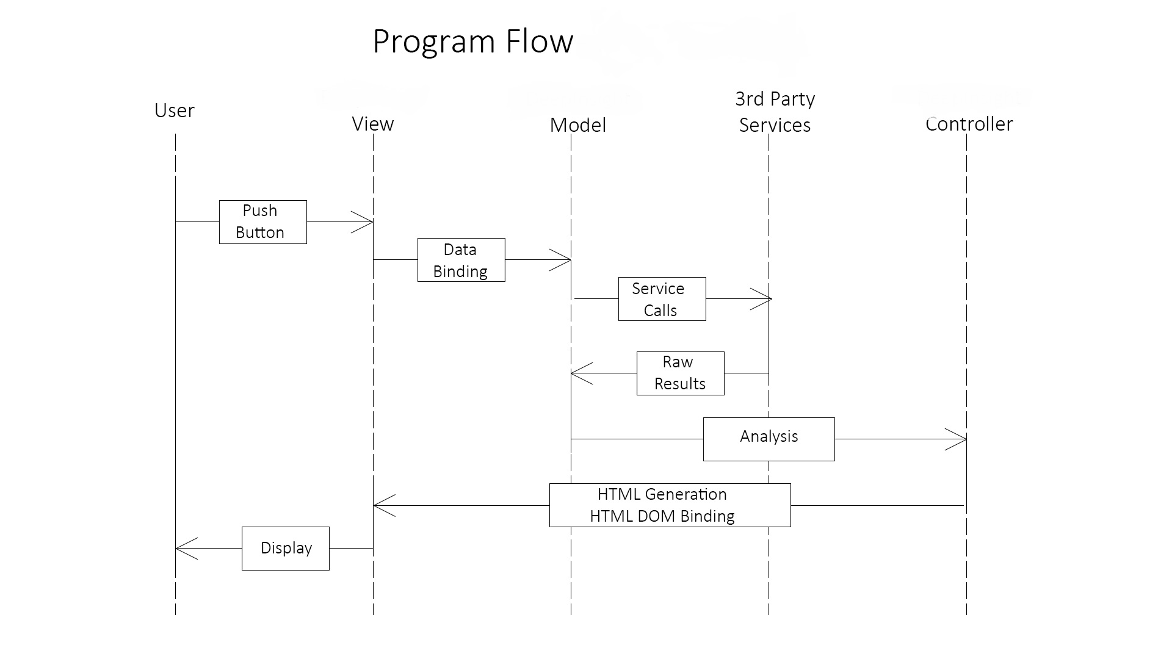
Architecture
Here’s another view at the data flow within the application

Slide 6
Key Features
Platform Independent: Smart LookUP can run on various devices with ease. Once deployed, it can be easily installed from the Chrome Web Store.
Modularity: Using REST APIs for communication among different component with JSON objects brings the modularity in our design and make the components independent of each other.
This helps us to customize the extension to different customers uniquely
User Friendliness: The UI is simple to use and intuitive. The user can enable or disable Smart LookUP easily. The user has no need to switch among multiple windows as relevant content from their favorite search engines are available to them in a ready to use manner. It increases user’s efficiency to research the web content and save the user’s time.

Slide 7
Business Plan Everyone of us is different !
Smart LookUP empowers users by providing relevant content from the web in real time. A user can use it to research the content of any page comprehensively, in the comfort of the same tab.

Slide 8
Business Plan Everyone of us is different !
Smart LookUP empowers users by providing relevant content from the web in real time. A user can use it to research the content of any page comprehensively, in the comfort of the same tab.
Different users have specific needs and care about different content.

Slide 9
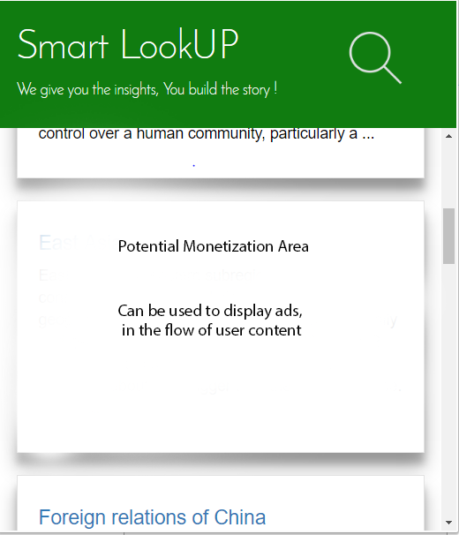
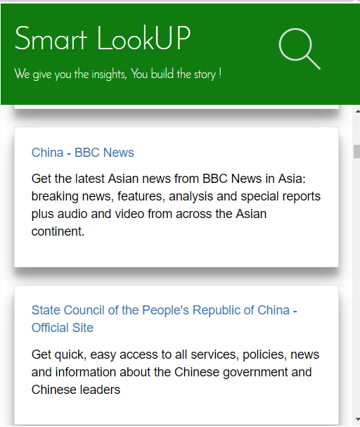
Business Plan Monetization (free version)
Cards can be used to show ads that can be monetized easily.
We can charge services, so that their results appear higher in the search.

Slide 10
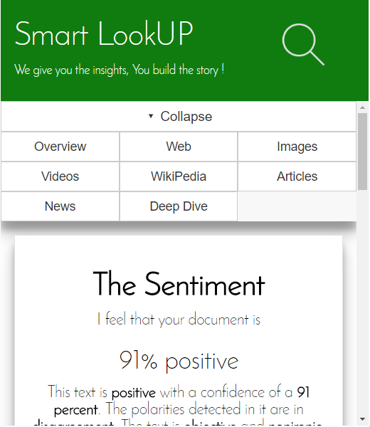
Business Plan Monetization (paid version)
Currently only a few services are integrated into the extension.
Interested users will be able to customize their own version of Smart LookUP, based on their domain of study.
Someone in academia, can opt to choose google scholar search, while a different person in stock markets might be only interested in real time news.
As, individual third party services could be expensive, we can reduce the overhead by distributing the cost over multiple subscribed users.

Slide 11
THANK YOU

